Slide 1

olorado Restaurants
A look into the top 20 Italian Restaurants in
Denver, Fort Collins, and Colorado Springs.
Sylvia Blake, Chris Jordan,
Kayla Swanson & Calley Breslau

Slide 2
Motivation
We had a unique array of backgrounds, but all have a passion for food. Since Italian is the favorite food of America (see class 1 for reference), we decided to examine the ratings and price in three major Colorado cities of the top 20 restaurants using the Zomato API.

Slide 3
Hypothesis
We believed that Denver would have the highest rated and most expensive restaurants as it is the largest city in Colorado.
We assumed that Colorado Springs would have higher ratings and prices than Northern Colorado, again as it is more populated.
We assumed that as prices increased the ratings would increase as well.
Do we know the best restaurants in Colorado and do we agree with Zomato (less data oriented and more of a group debate)?

Slide 4
The Questions du Jour
What are the top 20 Italian restaurants by price and rating in Denver, Northern Colorado (Fort Collins area), and Colorado Springs?
What were the average ratings and price by city?
Is there any correlation between price and rating in the three cities?

Slide 5
The DATA

Slide 6
Highest Rated Restaurants in Each City – Top Ten
Denver | Colorado Springs | Northern Colorado
Osteria Marco | Borriello Brothers Real NY Pizza #1 | Coopersmith’s Pub & Brewing
Big Bill’s | Paravicini’s Italian Bistro | Uncle’s Pizza & Grill
Café Jordano | Il Vicino Wood Oven Pizza | Poppy’s Pizza & Grill
Woody’s Woodfired Pizza | Mollica’s Italian Market and Deli | Krazy Karl’s Pizza
Hops & Pie | Pizzeria Rustica | Arte Pizzeria
Shells & Sauce | Biaggi’s Ristorante Italiano | Roma Restaurant & Lounge
Marco’s Coal-Fired | Joey’s Pizza | Chicago’s Best
Panzano | Savelli’s Pizza | Pizza Casbah
Maggiano’s Little Italy | Poor Richard’s Restaurant | Beau Jo’s Pizza
Parisi | BJ’s Restaurant and Brewhouse | Sweet Basilico Cafe
Most restaurants in the top 10 for Denver fall within the $25 price range, with Panzano in the $70 range.
All of the top rated Colorado Springs and Northern Colorado restaurants are $25 or less.
* Average cost per two individuals – provided by restaurant

Slide 7
Highest Rated Restaurants in Each City – 11-20
Denver | Colorado Springs | Northern Colorado
Trattoria Stella | Panino's Restaurant | Mama Rose’s
Maggiano Little Italy | La Bella Vita Ristorante Italiano | The Dunraven Inn
Carmine's on Penn | Duca's Neapolitan Pizza | Pulcinella Pizzeria
Mellow Mushroom | Back East Bar & Grill | Santeramo's Pizza House
Colore Italian Restaurant & Pizzeria | Johnny's Navajo Hogan | Village Pizza
Virgilio's Pizzeria & Wine Bar | Bella Panini | Garlic Knot
North Italia | Billy's Old World Italian Buffet | Domenics
Lil Ricci's Pizza | California Pizza Kitchen | Biaggi’s Ristorante Italiano
Cucina Colore | Paninos Restaurant | Pourhouse Bar and Grill
Armando's Ristorante Italiano | Roadrunner Pizza & Pasta | Cheesy Lee's Amazing Pizza
* Average cost per two individuals – provided by restaurant

Slide 8
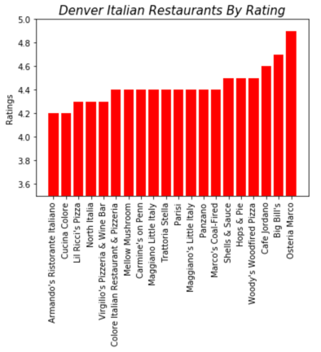
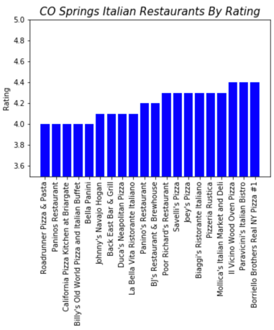
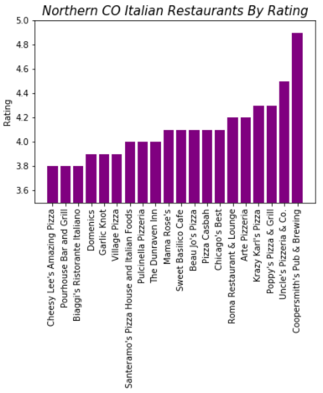
average Restaurant RATING BY City
Denver
Colorado Springs
Northern Colorado
* Average cost per two individuals – provided by restaurant
Notes:
The Denver Italian Restaurants By Price chart shows a variable price range for the top 20 Italian restaurants in Denver. Prices ranged from 10𝑡𝑜10to80 with most restaurants falling within the $25 price range. The Colorado Springs Italian Restaurants by Price shows the cost of an average meal ranges from 10𝑡𝑜10to40, with most restaurants falling within the $10 price range. Prices for restaurants in Colorado Springs seems to be less than prices in Denver. The Northern CO Italian Restaurants By Price chart shows that most restaurants in Northern Colorado are at or below the $25 price range. This chart suggests that the price of Italian food in Colorado Springs and Northern Colorado is somewhat similar while Denver has more higher priced restaurants.

Slide 9
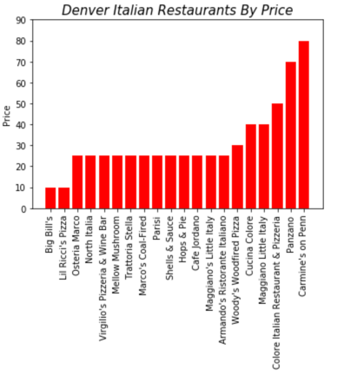
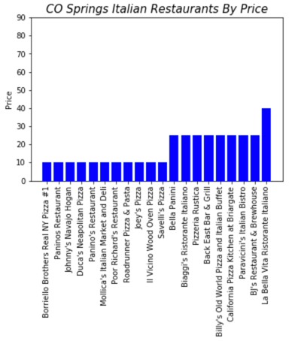
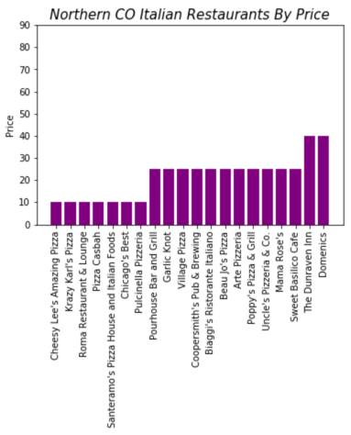
Average Restaurant price By City
Denver
Colorado Springs
Northern Colorado
Notes:
In the Denver Italian Restuarants by Rating chart, we see the ratings for the top 20 Denver Italian restaurants range from 4.2 to 4.8 with the most common rating being 4.4. The Colorado Springs Italian Restaurants By Rating graph shows a limited range of ratings from 4.0 to 4.4. This graph suggests that the quality of restaurants in Denver is higher than in Colorado Springs. The Northern Colorado Italian Restaurants By Rating show the most variability in ratings for the top 20 Italian restaurants. The ratings ranged from 3.8 to 4.8, suggesting limited quality restaurants for Italian in Northern Colorado when compared to Denver and Colorado Springs.

Slide 10
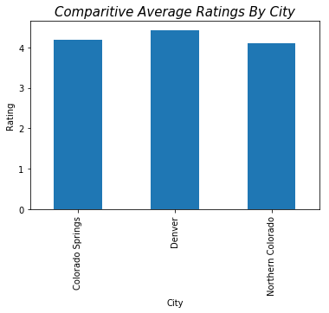
Comparative Average Ratings by City
The Comparative Average Ratings By City chart shows fairly consistent ratings across Colorado Springs, Denver, and Northern Colorado restaurants.
However, Denver shows the highest ratings and Northern Colorado shows the lowest ratings.

Slide 11
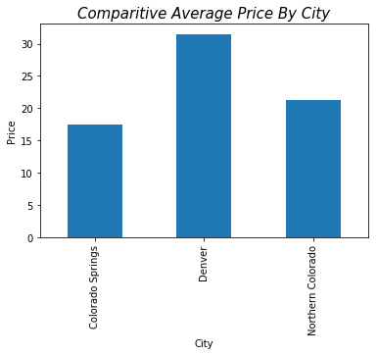
Comparative Average Price by City
The Comparative Average Price By City chart shows Denver with the highest average for cost when looking at the top 20 highest rated Italian restaurants and Colorado Springs has the least expensive restaurants.

Slide 12
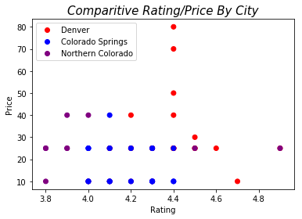
Correlation Between Price and Rating
The Comparative Rating/Price By City chart shows that there is not a significant relationship between price and rating when looking at the top 20 highest rated Italian restaurants in Denver, Colorado Springs, and Northern Colorado. However, when looking at Denver restaurants, indicated in red, there is a slight trend toward restaurants with lower prices having higher ratings.
The highest rated Italian restaurant is from Coopersmith’s, which is more known for its beer and may not have the high rating due to its Italian food
offerings. This should be taken into consideration.

Slide 13
Correlation Between Price and Rating
There is minimal correlation between rating and price between all cities. Denver did have a more significant correlation than either Colorado Springs or Northern Colorado.
Shockingly, the higher rated Denver restaurants have a lower price point compared to the other options.
Overall, the highest rated and highest priced Restaurants are in Denver.
Coopersmith’s Pub in Fort Collins was an outlier. After looking at reviews on Zomato it appears to be a local’s favorite which could have skewed the data.
Lower rated, lower priced restaurants fell around Northern Colorado.
Northern Colorado tends to be more rural and have a lower income than other parts of the state which means restaurants will be less expensive which can lean towards lower reviews.

Slide 14
Trouble Shooting the code (and Data)

Slide 15
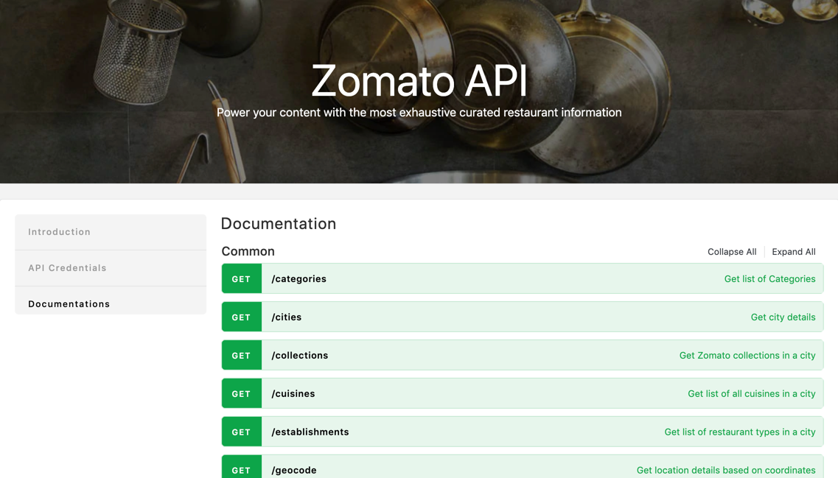
API Documentation
Zomato API website offered several ways to access data.
When reviewing the documentation, it was unclear on how to pull the wanted data causing issues to gather and combine data.
Some of the wanted access points were dependent on data from other APIs.
Our solution was to obtain id numbers/codes from different APIs to obtain the data necessary for this analysis.

Slide 16
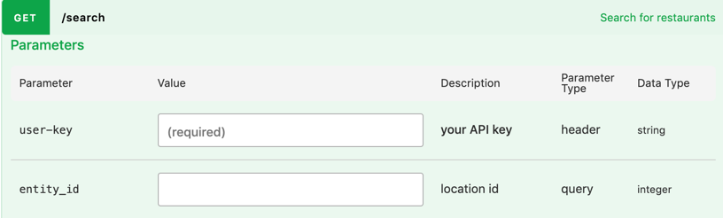
API Documentation
The biggest challenge was obtaining City Names.
City Names were not a parameter for any of the APIs.
API documentation stated to obtain a city, use the Entity ID parameter.
After troubleshooting, the correct parameter, City ID, was needed to extract the data needed to create the data frame.

Slide 17

Realizing data is not a number
Sorting rating and price data were rendering unexpected results.
It was later determined that Price and Rating were stored as a string.
astype(float) Panda function resolved the issue by casting as a float.

Slide 18
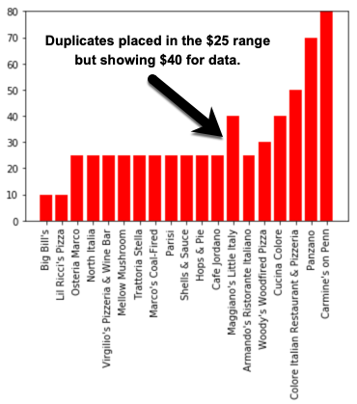
Sorting by price/rating with Duplicate restaurant names
Duplicate restaurants (Maggiano’s) created issues in our data.
Example – one restaurant was priced at $25 and the other at $40. The data pulled in the $25 slot, but was showing $40.
We were able to use the dataframe.at Panda function applied to the column index to rename one of the Maggiano’s Little Italy to just Maggiano Little Italy to pull in all 20 data points without impacting the sort function of the graph.

Slide 19
Finding the best way to display data
Chart types were limited due to analyzing price and ratings.
Our conclusion was that the data was best and most simply presented through Bar Charts with one Scatter Plot.

Slide 20
Post Mortem

Slide 21
Data Flaws
Our API use had a limitation of calling only 20 results into the data set per given request.
People are more prone to review their bad experiences than their positive ones. Assuming that only one of every 10 happy customers leaves a positive 5★ review, it would take four 5★ reviews to make up for each 1★ review, you can figure it takes 40 positive customer experiences to make up for a single bad review.¹
When we analyzed the data, we did not take into account how many reviews each restaurant had. Coupled with the gravity of bad reviews, it is easy for the data to be skewed in either direction. It might not be the food getting the reviews, it might be the atmosphere.
Larger population – More Reviews, More Opinions. As population increases, so does the amount of restaurants. This can cause a data skew due to larger amounts of reviews and more restaurants, but can also allow for varied onions in the reviews.
1. The Secret Ratio That Proves Why Customer Reviews Are So Important
Andrew Thomas - https://www.inc.com/andrew-thomas/the-hidden-ratio-that-could-make-or-break-your-company.html

Slide 22
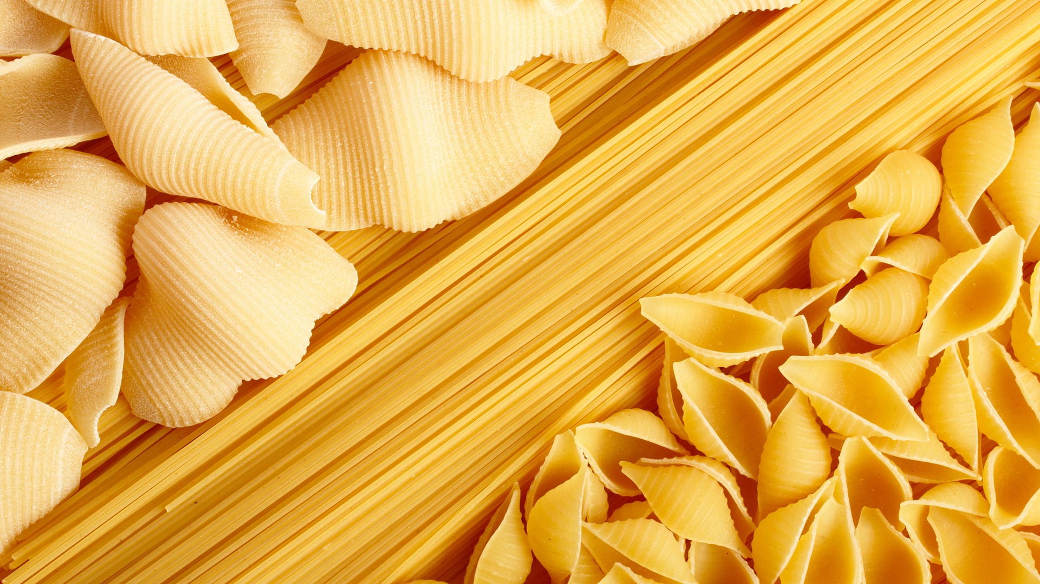
Q & A

Slide 23
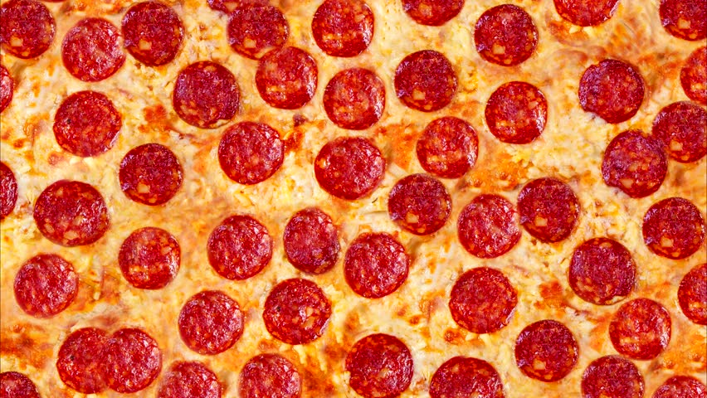
Thank You!

